Slide 1


Dr.N.G.P. Arts and Science College (Autonomous)
Coimbatore 641 048
STEGDETECT
PRESENTED BY :
Mr.V.Balaji
(191CA008)
GUIDED BY :
Dr.A.NIRMALA M.C.A., M.Phil. Ph.D

Slide 2
ABSTRACT
This is the one of the cyber crime happens in the digital world
This is the project to describe about the digital steganography detect
The steganography crime was happen in the Network this Revert to this crime
It is the method of detect Digital steganography on the computing field
This steganography is about LSB Insertion method

Slide 3
Steganography is the practice of hiding information inside something normal-looking. Cybercriminals use steganography to hide stolen data or malicious code in images, audio files and other media
Briefly about steganography

Slide 4
How steganography works depends on the type of information that’s hidden and the type of file or site it’s hidden in. Many steganography methods hide information in the way of LSB This revolve about the digital world
CYBER CRIME WORKS

Slide 5
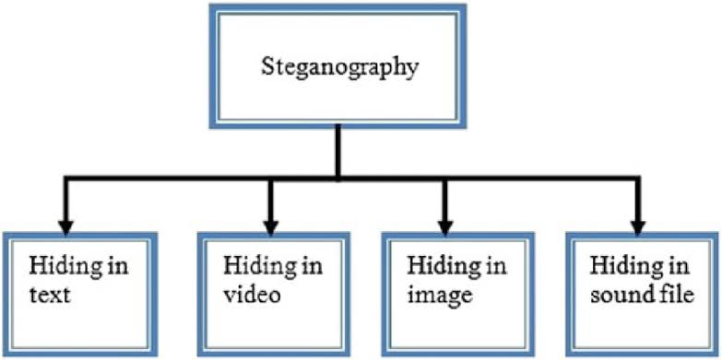

Flow Chart

Slide 6
Module
User
Browser
detect

Slide 7
Software requirement
Windows :
500 mb available RAM Larger Capture file require more RAM
500 mb available disk space . Capture files requires additional disk space need to run Wireshark
Unix , linux and BSD :
arch linux
freebsd
Debian
red hat enterprise linux
fedora
centOS

Slide 8
Existing system
Data-Loss Prevention tool and email security
Proposed System
It function in computer systems to check image file has embed text

Slide 9
Thanking You

